Slide 1
Ixonia: past, present, and future
Comprehensive Plan Open House
June 29, 2023

Slide 2
Planning for the Future – What is a Comprehensive Plan?
Required by Wisconsin Statutes for communities that adopt ordinances regulating land use and development
Document that compiles data and maps illustrating the Town’s history and current conditions
Opportunity to envision the future – what changes will the Town need to adapt to and what changes would residents, business owners and others like to see?
Vision and action plan to guide the Town in the future development of the community
Shaped by public participation

Slide 3
Elements of the Plan
Issues and Opportunities
Transportation
Utilities and Community Facilities
Intergovernmental Cooperation
Implementation
Agricultural, Natural, and Cultural Resources
Land Use
Economic Development
Housing
Notes:
Gold – Issues and Opportunities (what are the most important things to focus on – shape all the other elements); Green – Natural Resources (what do we want to preserve, protect, or enhance opportunities for Town residents to use and enjoy); Dark blue/gray – Built Environment and Socioeconomic Activity (how can the Town improve Ixonia as a place to live, work, do business, obtain goods and services, and enjoy recreation and social activities); Orange – Regulation of Land Use (what types of land use, in what amounts, where, requirements and regulations are needed to provide for the protection of natural resources and desired development of the built environment and socioeconomic activity); Blue – Town Government (what are the steps the Town needs to take to put the plan into action)

Slide 4
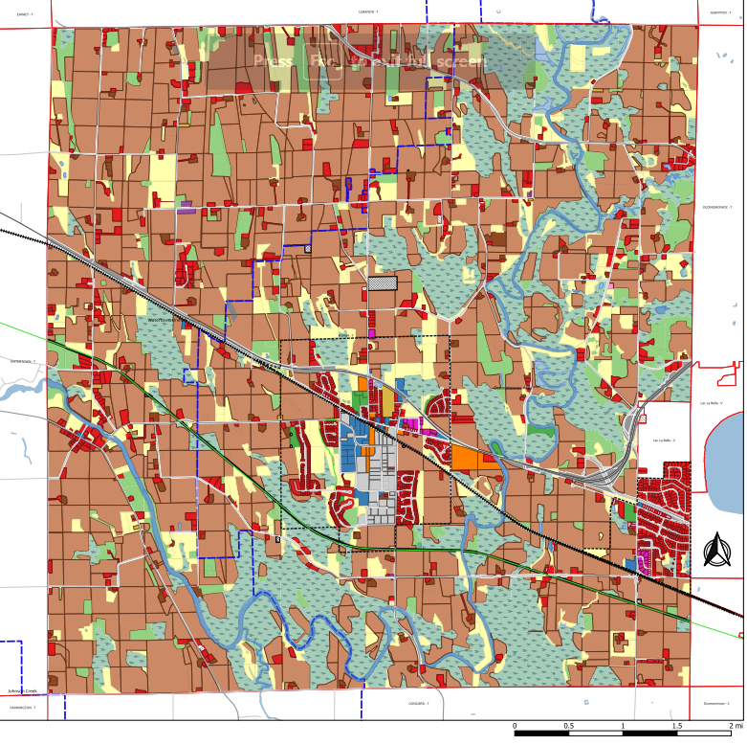
Planning Area and Existing Land Use

Slide 5
Population Growth in ixonia
Ixonia is larger than other Jefferson Co. towns and villages
Fastest growing community in Jefferson County

Slide 6
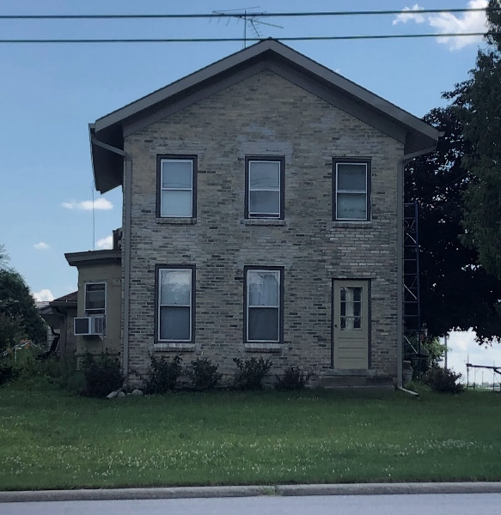
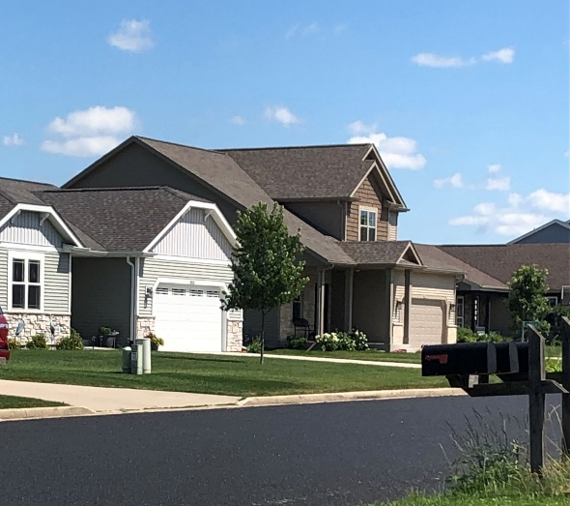
Ixonia offers a variety of housing

Slide 7
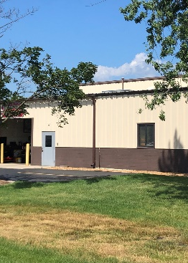
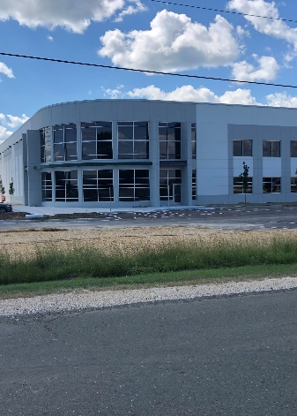
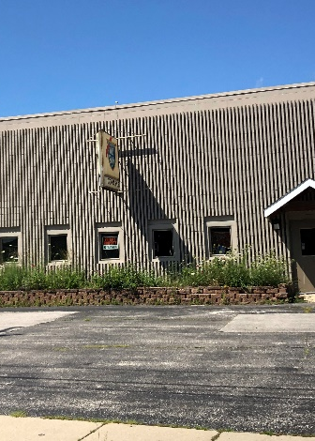
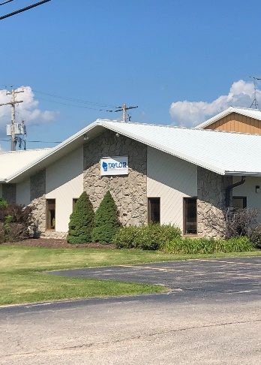
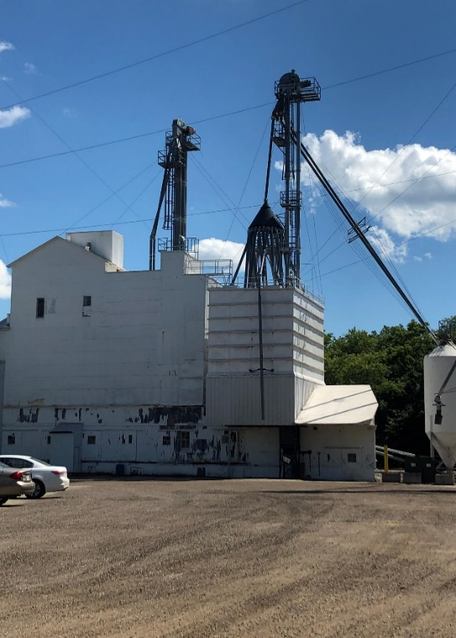
Ixonia has a successful business / industrial park providing jobs and a solid tax base

Slide 8
Property tax base of Jefferson County Communities
Ixonia – Residential 80% / Commercial 10% / Industrial 6% / Agricultural 1% / Other 4%

Slide 9
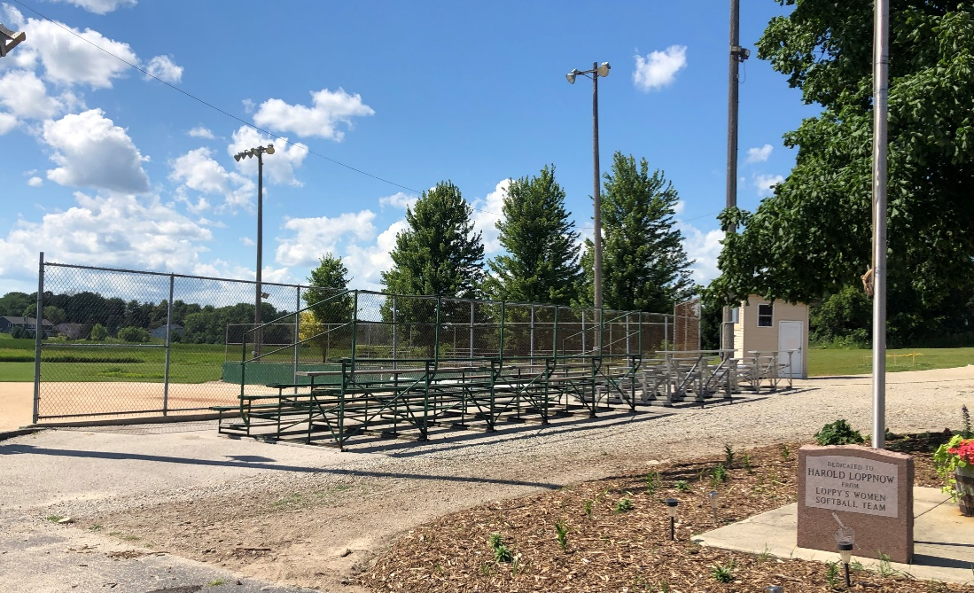
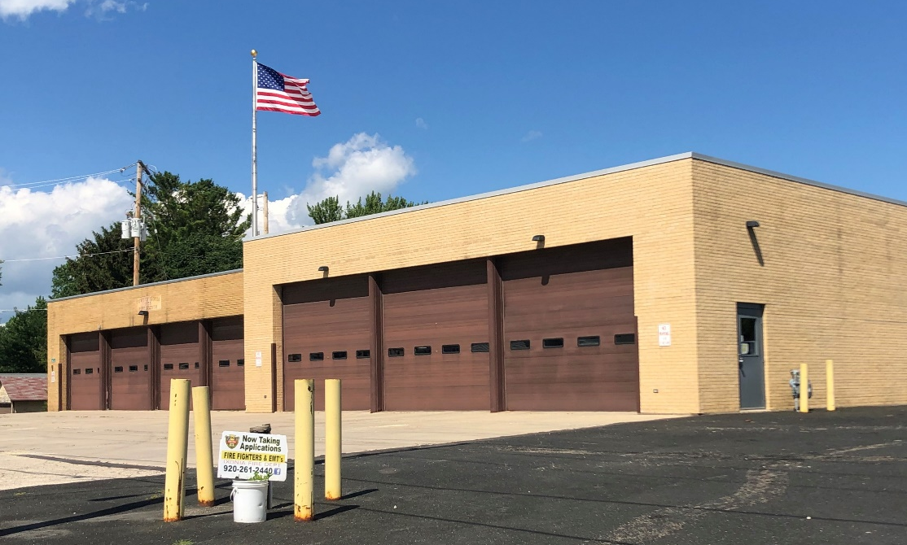
Town Government services in ixonia
Clerk/Treasurer, Highway & Parks, Fire & EMS, Solid Waste & Recycling, Sanitary Sewer Service Districts
New Wastewater Treatment Plant will have capacity to serve about 2,400 additional population and significant new industry
Fireman’s Park
Ixonia Fire Station

Slide 10
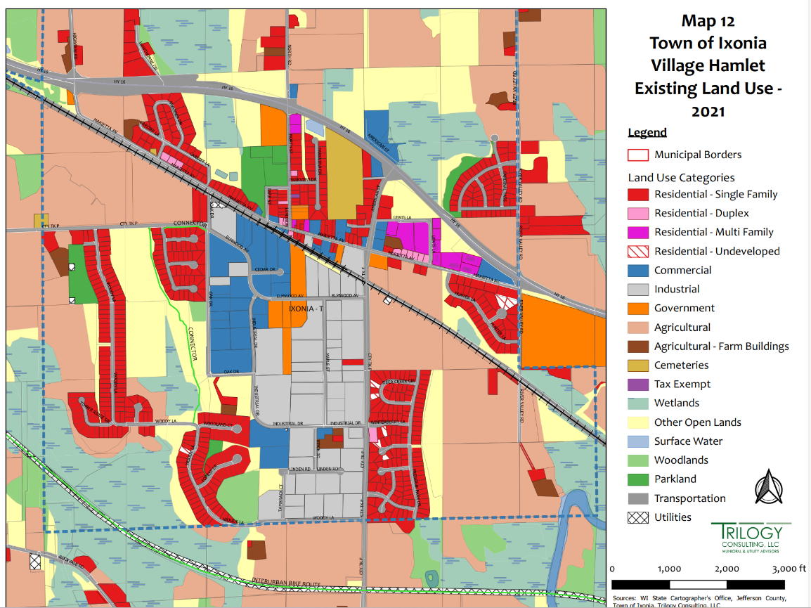
Current Town Facilities
4
1
3
Town Hall
Current Wastewater Treatment Plant (WWTP)
Recycling
Fire Station / DPW
New WWTP
2
5

Slide 11
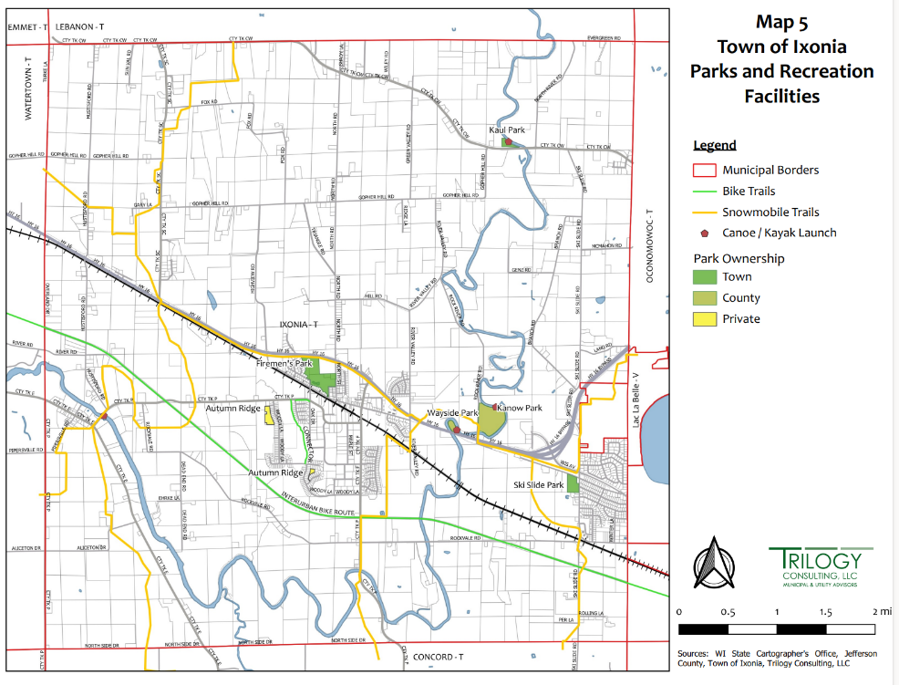
Current Park and rec
Facilities
2
1
5
4
Fireman’s Park (Town)
Kaul Park (Town)
Ski Slide Park (Town)
Kanow Park (County)
Wayside Park on Rock River (County)
3

Slide 12
Priority Issues for Ixonia’s Future Identified by Community Survey
Preserve Rural Small-Town Atmosphere
Preserve Natural and Open Space
Keep Established Businesses and Industries
Maintain and Improve Local Roads
Attract and Support More Retail and Service Businesses
Improve Public Safety and Security
Enhance Park and Recreation Activities
Improve Marietta Avenue
Improve the Image of the Industrial Park
Plan for Growth
Maintain and Improve the Sense of Community
Develop Vibrant, Well-Planned Neighborhoods

Slide 13
Key Future Needs & Objectives
Housing
Identify suitable areas for 750-1,000 new residential dwelling units in areas that already have ‘urban’ development and sewer service
Written development standards for residential subdivisions to address issues such as road width for street parking and snow removal, sidewalks, lighting
Transportation
Adjust budget to resurface or reconstruct 2-3 miles of roads per year (currently 1.5 miles/year)
Road construction standards for new subdivisions
‘Complete Streets’ policy to address safety issues for all users (bicycles, pedestrians, UTVs, etc)
Work with Jefferson Co. and Ixonia Elementary School to address safety concerns at key intersections and school drop off
Continue to work with Wisconsin Department of Transportation (DOT) to increase safety of intersections on Highways 16 and F in future DOT plans

Slide 14
Key Future Needs & Objectives
Town Services
Transition to full-time Fire and EMS service (currently 2 full-time and 30 paid on-call)
Continue to explore cost-effective options for dedicated law enforcement
Continue to evaluate staffing needs for potential full-time Town Administrator and additional support staff as population and needs grow
Explore opportunities to work with other municipalities or organizations to offer recreation programs (especially for youth and seniors)
Utilities and Community Facilities
Prepare a comprehensive space needs and location study for future Town facilities
Town Hall / Community Center
Public Safety Building (Fire and Police)
Public Works / Recycling Facility
Regularly update the Town’s Comprehensive Outdoor Recreation Plan

Slide 15
Key Future Needs & Objectives
Agricultural, Cultural, and Natural Resources
Continue to follow Jefferson County zoning for farmland preservation and future growth
Economic Development
Provide suitable areas for industrial park expansion
Identify areas for new small to medium commercial and retail businesses and create a plan to attract these businesses
Work with business owners in the Industrial Park to follow deed restrictions for an attractive park for current and new businesses
Detailed plan to improve Marietta Avenue and redevelop the Rollex site
Explore use of Tax Incremental Finance and Jefferson County ThriveED programs to support public and private improvements

Slide 16
Key Future Needs & Objectives
Intergovernmental Cooperation
Considerations for any new Town facilities
Provide emergency shelter for Ixonia Elementary School in future Town facilities
Opportunities to cooperate with other units of government to expand services or provide services more efficiently.
Continue to explore opportunities to work with Jefferson Co. or other municipalities for law enforcement service
Community Liaison position (or Town Administrator) to communicate with other units of government and identify opportunities for cooperation

Slide 17
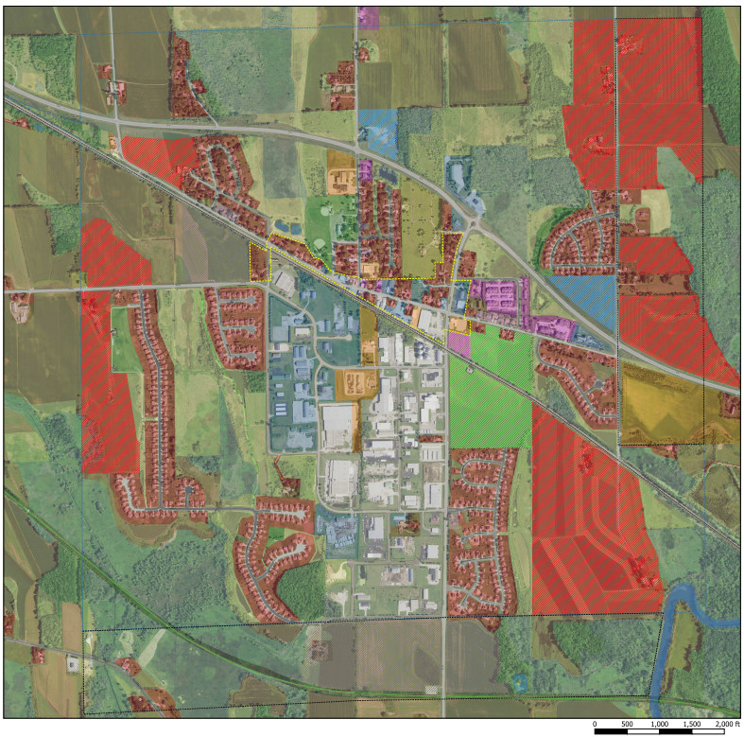
Areas of Future Development
Notes:
Focusing on this area because this is where development will be focused

Slide 18
Opportunities to comment on the plan
Tonight – ask questions, talk with Committee members, fill out a comment card
Proposed Comprehensive Plan posted on Town website – goal of July 20
August 23 at 7 pm – Presentation of proposed Comprehensive Plan to Ixonia Plan Commission
October 9 at 7 pm – Town Board public hearing for approval of Comprehensive Plan
Email comments to the Town anytime at https://townofixonia.com/contact-us/

Slide 19
Questions?
Thank you for sharing your thoughts and helping shape the future of Ixonia!

